Slide 1
Pictures of the Civil War

Slide 2
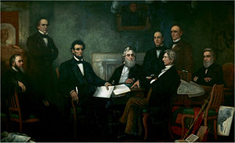
Describe 3 things in the picture

Slide 3
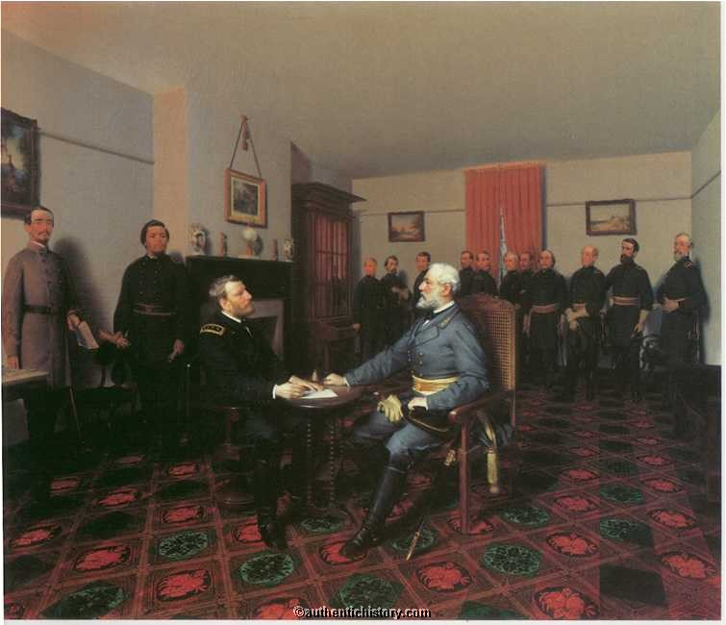
April 9, 1865- What is happening here?

Slide 4
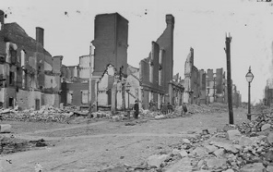
What do you see in this picture?

Slide 5
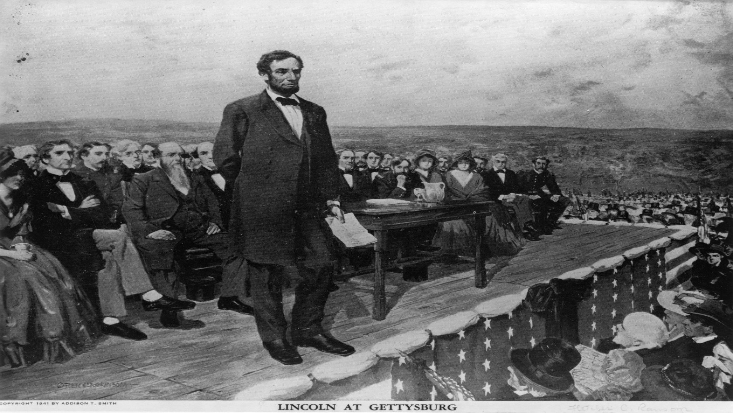
What are some things that you see here?

